Slide 1
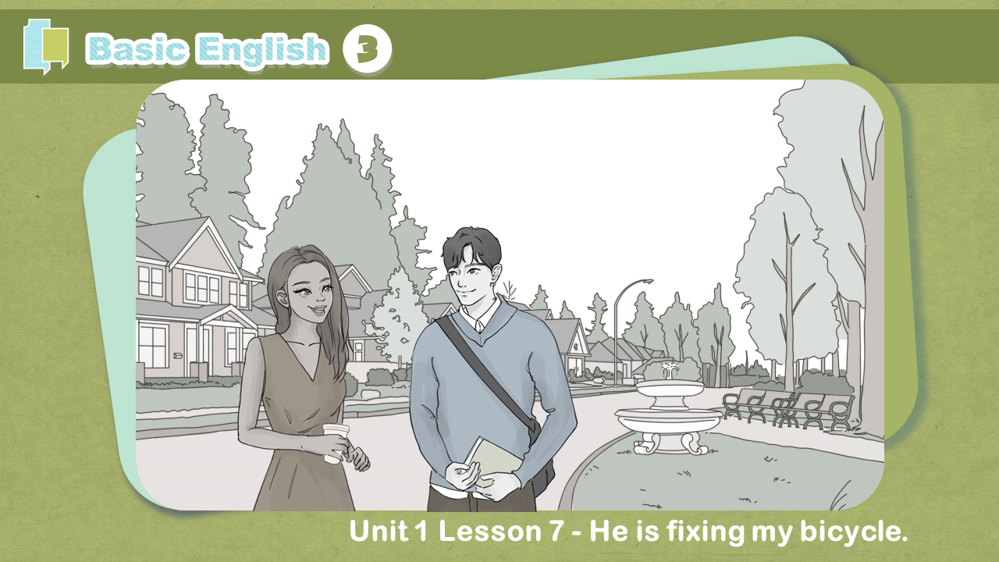

Slide 2
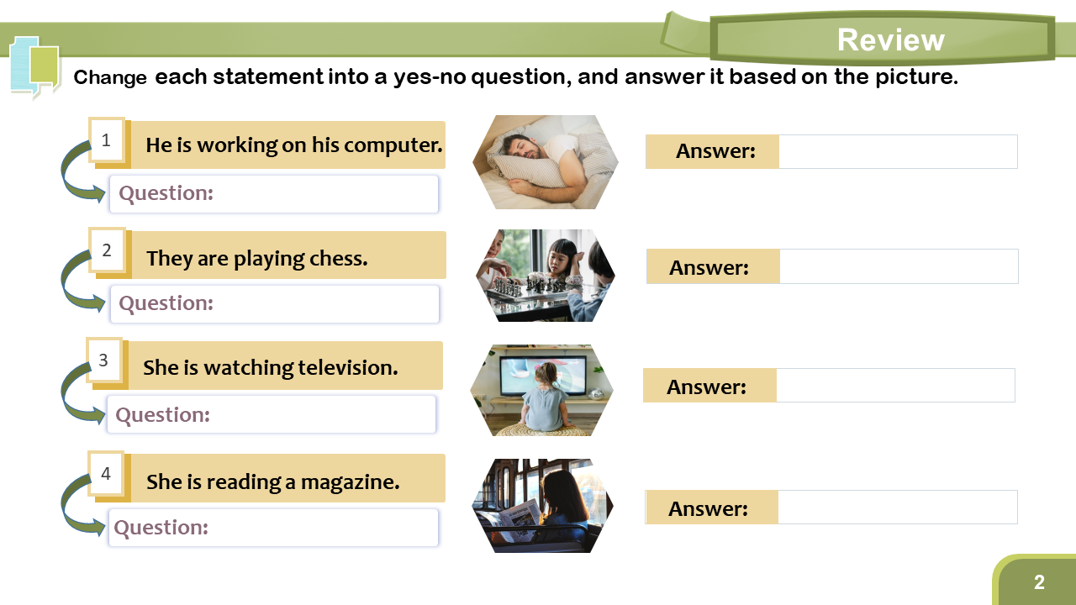
Notes:
Answers:
1. - Is he working on his computer? - No, he isn’t. He is sleeping.
2. - Are they playing chess? - Yes, they are. They are playing chess.
3. - Is she watching television? - Yes, she is. She is watching television.
4. - Is she reading a magazine? - No, she isn’t. She is reading a newspaper.

Slide 3
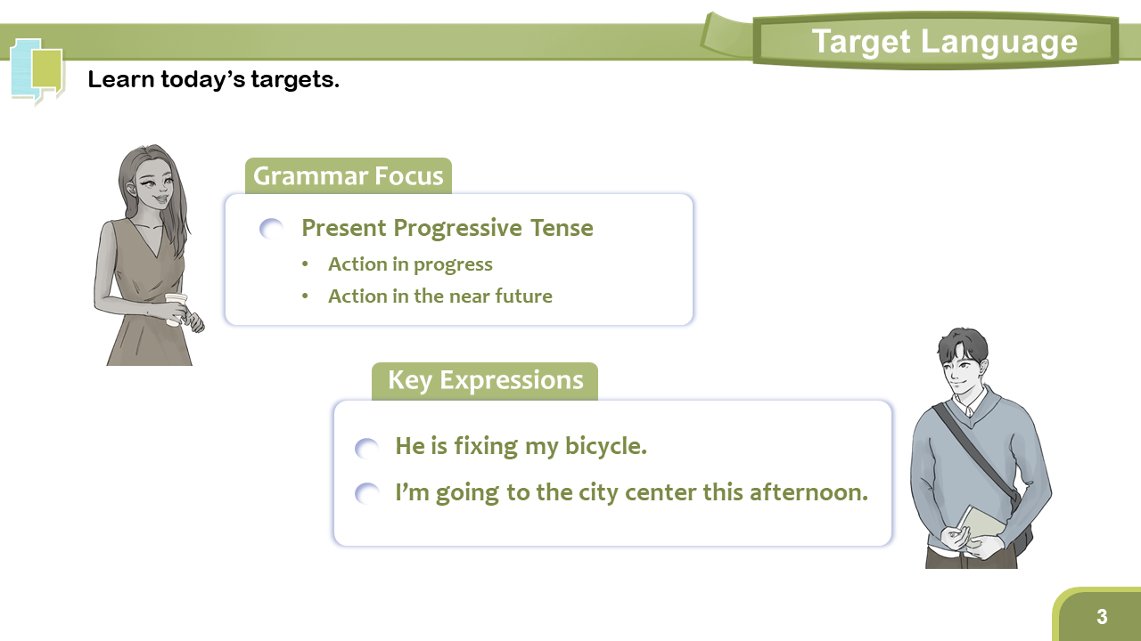
Notes:
1. Introduce today’s targets.
2. Read the sentences first, and let the student repeat them.

Slide 4
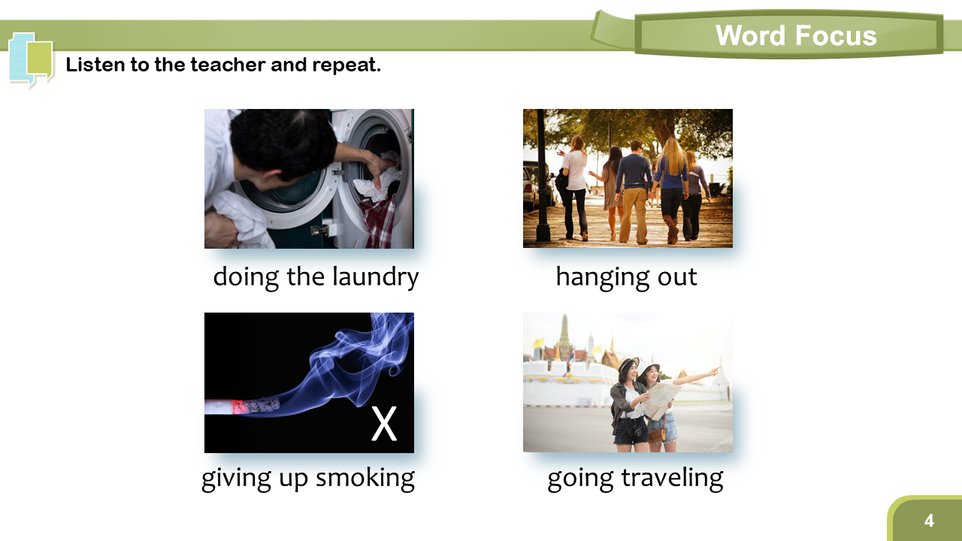
Notes:
1. Read the words, and let the student repeat.
2. Explain if necessary.

Slide 5
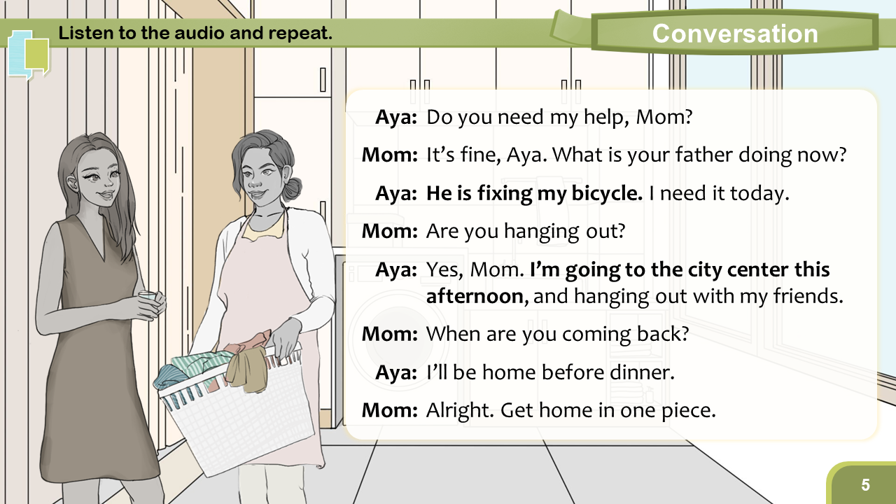
Notes:
1. Play the audio.
2. Do a role-play with the student.
3. Questions:
Q1. What is Aya’s mom doing? (She is doing the laundry.)
Q2. What is Aya going to do this afternoon? (hint: hanging out with friends)

Slide 6
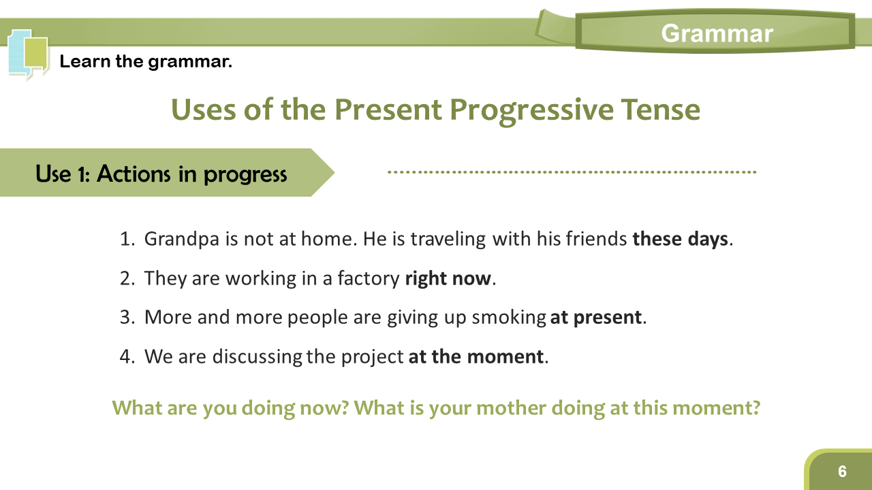
Notes:
1. Introduce the use.
2. Ask the student to read the example sentences.
3. Stress the time adverbs in bold.
4. Ask the two questions.
Next slide: The other use of the tense

Slide 7
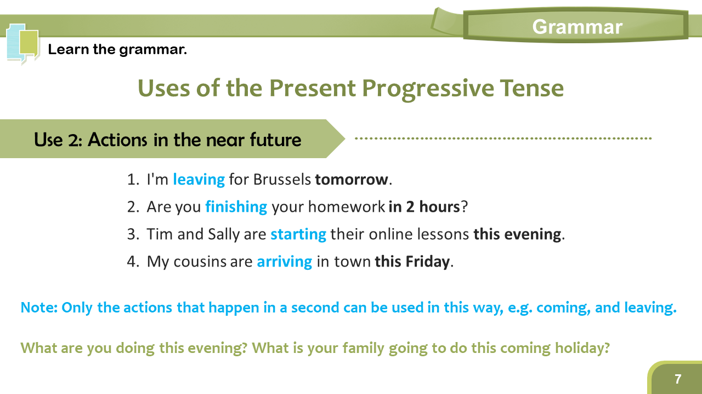
Notes:
1. Introduce the use.
2. Ask the student to read the example sentences.
3. Stress the time adverbs in bold.
4. Explain the note.
5. Ask the questions.

Slide 8
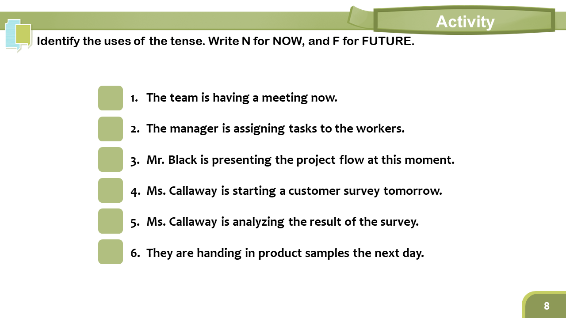
Notes:
1. Ask the student to read the sentences, and write N or F.
--------------------
N, N, N, F, N, F

Slide 9
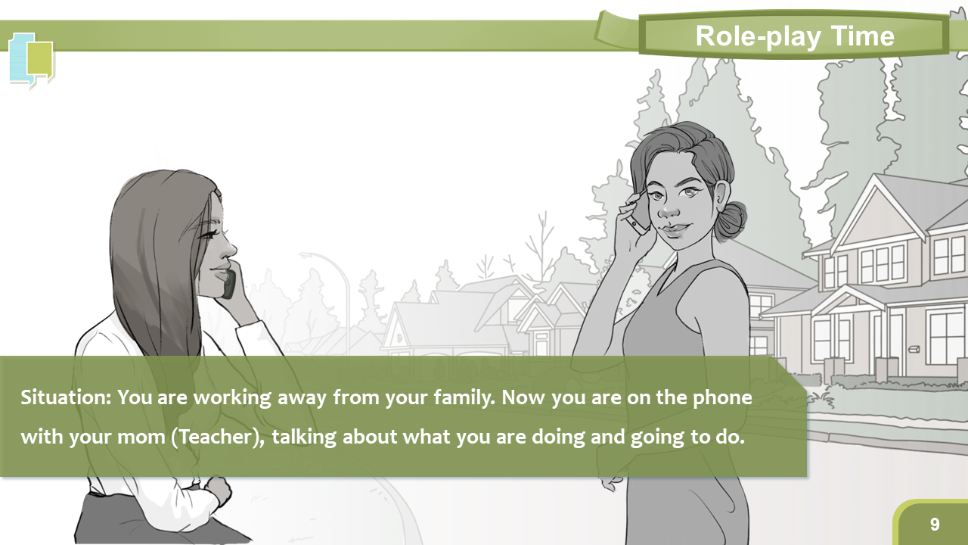
Notes:
1. Read the situation, and do a role-play.
----------------------
Sample:
T: Hi dear. How are you?
S: I’m doing great, Mom.
T: What are you doing now?
S: I am walking home at the moment. I’m almost home.
T: Are you coming home for the coming holiday?
S: Yes. Are you planning to hold a home party?
T: Yes. We’ll be waiting for you then!
….

Slide 10
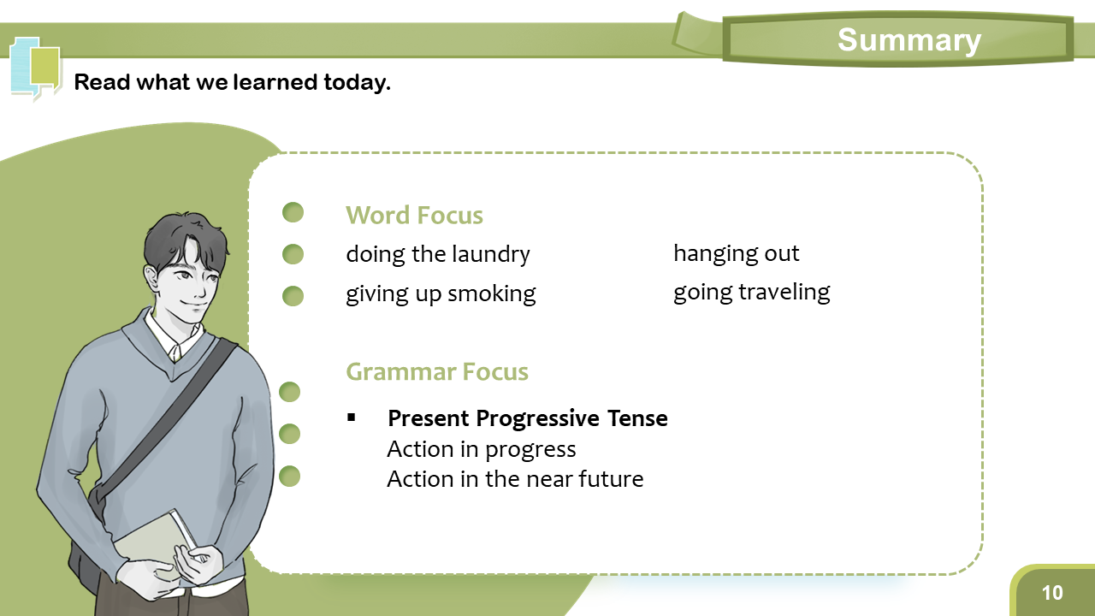
Notes:
1. Summarize today’s lesson.

